Slide 1
Intro to Software Processes

Slide 2
What We Want
Need or Idea
Software
source: Bruegge, Object-oriented Software Engineering
Notes:
One of the problems with complex system design is that you cannot foresee the requirements at the beginning of the project. In many cases, where you think you can start with a set of requirements, that specifies the completely the properties of your system you end up with....

Slide 3
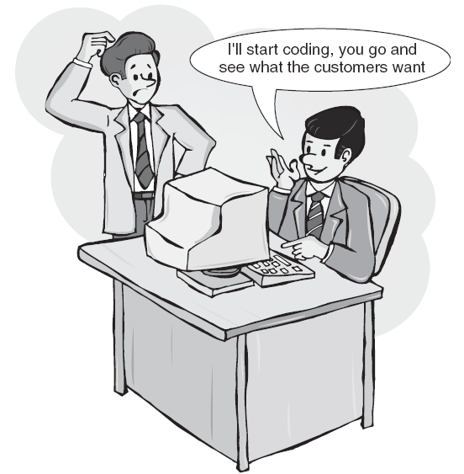
Why can't we just write the program?

Slide 4
Realities of Software
Obstacles to writing good software.
Change.
Useful software is complex.
Communication - don't clearly understand what the user(s) want. They don't understand us.

Slide 5
The Problem
"Programming is fun, but developing quality software is hard. In between the nice ideas, the requirements or the "vision", and a working software product, there is much more than programming.
Analysis and design, defining how to solve the problem, what to program, capturing this design [...], review, implement, and evolve is what lies in the core of this book."
[Forward to textbook by Philippe Kruchten]

Slide 6
Intrinsic Complexity of Software
"There is no single development, in either technology or in management technique, that promises even one order of magnitude improvement in productivity, in reliability, in simplicity."
"No Silver Bullet" by Frederick Brooks. Computer, 1987
See also page 5-6 for Brooks comments about object-oriented approach.

Slide 7
What is a Software Process?
A process is a method for doing or producing something.
A software process is a method for producing software.
"Producing software" includes
specification
design
construction
documentation
transition
maintenance
improvement
Managing the project involves
obtaining resources
measuring
tracking
reviews
analyzing results and acting on them

Slide 8
Do You Have a Process?
Everyone who develops software uses a process.
Process may not be formal (informal).
You may not be aware of it (implicit, not "defined").
It changes every time you develop a new application (ad hoc).

Slide 9
Exercise
Identify a process you use repeatedly in your daily life.
Why do you follow this process?
Are there any advantages to using a process?
Have you improved your process?

Slide 10
Exercise 2
What process "activities" did you use in your eXceed Camp project?
Did you process have "phases"?

Slide 11
Do We Need a Formal Process?
Not necessarily...
  Teams can have “jack-of-all-trades” programmers who understand the business of the organization.
  Master developers (guru) take initiative and build the software without consensus or planning.
  A highly capable project manager may be willing to put in an enormous effort.
  Developers put in extra time to get project done.
eXceed Camp

Slide 12
Problems with an Implicit Process
What are problems of relying on implicit process?
Imagine using your eXceed Camp process every week, for a year.

Slide 13
Problems with an Implicit Process
1. Depends on motivated & talented individuals.
  what if your best programmer/architect quits?
2. Not repeatable or predictable.
  if you can't predict how long the next project will take, then how can you bid (estimate cost)?
3. Stress / burn-out.
  Too much pressure on team.
  Uncertainty and O.T. lead to frustration, burn-out.
  No slack time for HR development.

Slide 14
Another Problem...
1. We learn programming on small projects.
2. We develop an implicit process that works...
we get "A"s in our courses!
Obviously, we are great software engineers !
Problem:
our implicit process does not scale to large problems.

Slide 15
Advantages of a Defined Process
Clarity: team knows who should do what and when, expected outputs
Efficient: avoid wasting time thinking of what must be done
Enables planning
Predictable
Repeatable (related to predictability)
Trackable (measuring predictability)
Quality assurance
Basis for improvement

Slide 16
Process Disadvantages
overhead
diminish sense of spontaneity or creativity
may be the wrong process for the project
初
心
Beginner's Mind
The beginner's mind sees many possibilities;
the expert's mind sees one.
-- Japanese Aikido master

Slide 17
What is the Most Common Software Process?

Slide 18
What is the Most Common Software Process?
1. "Code and fix"
2. ad hoc (changes each time)
My Software Process
I have used since high school (I learned FORTRAN then)
1. think about the problem, sketch ideas on paper
2. start coding
3. as code grows, I realize that I need to restructure or redesign parts.
  modify previous code to support new, improved structure.
  goto step 2.

Slide 19
Code-and-Fix
Client
Requirements
repeat as needed
Code
[fail]
Test
[pass]
[fail]
Client Acceptance
[pass]
This is the implicit process for software development without any formal process model.
Delivery &
Maintenance

Slide 20
The Role of Process
People
Technology
Methods
The Desired Product

Slide 21

The Role of Process
People
Technology
"the glue that binds [guides] people, methods, and technology to create a product."
Methods
Process
The Desired Product

Slide 22
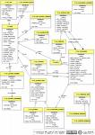
Model of a Process
People
Guidance
Standards
Templates
Technology
Roles:
Methods
Task
Task
Analysis
Design
Implement
Test
Activities:
Use Case
Description ...
Prerequisite...
Main Scenaria
1.....
2.....
3.....
Extensions: ...
Artifacts:
. . . . .
Desired Product
Communicate:
Measurements, Milestones, Documents

Slide 23
4 key factors in software development speed
Key factors that determine how well or quickly you can design, develop, configure, implement, ... a software project:
1.
2.
3.
4.

Slide 24
4 key factors in development speed
1. People
ability, knowledge, skills, motivation
2. Process
Customer focus
QA, risk management, lifecycle planning, revision control, ...
3. Product
Size and characteristics, phasing
4. Technology
Development environment
Tools

Slide 25
What is a Life Cycle Model?
A model of the phases that software project goes through
Serves as a guide for management of work
Model is an abstraction.
  omits some real-life complexity and detail

Slide 26
Classical Process Models
Waterfall
Rapid Prototype
V-Model
  going down V: waterfall
  going up the V: unit test, integration test, V&V, acceptance test
See Schach (Classical and O-O Software Dev't) for examples

Slide 27
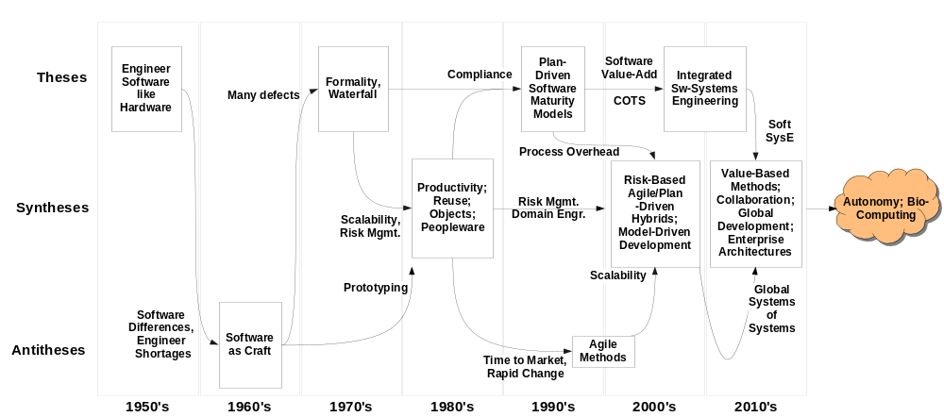
A Hegelian View of Software Engineering Evolution

Slide 28
Royce recognized that regression to previous steps often happened
The Royce Waterfall Model (1970)
SYSTEM
REQUIREMENTS
SOFTWARE
REQUIREMENTS
PRELIMINARY
PROGRAM
DESIGN
ANALYSIS
PROGRAM
DESIGN
CODING
TESTING
OPERATIONS

Slide 29
Linear Development
determine requirements for the product
analysis requirements to create a specification.
use the specification to construct a software design to satisfy it
build it
acceptance test by client, followed by delivery and maintenance
Requirements
Analysis
Design
Implementation
Acceptance Test
Delivery and Maintenance
Notes:
Each step is linked to the products (artifacts) of the preceding steps:
the specification created in the analysis phase must meet all the requirements
the design must satisfy all the requirements, as specified in the specification
the implementation must correctly realize all components of the design
Each phase includes:
documentation
validation: testing, check list of deliverables
reconciliation with results of previous phase

Slide 30
Waterfall Basic Phases
Requirements
Analysis
Design
The waterfall model recognizes that an activity may uncover a problem from a previous phase.
Previous phase must be reworked. This may in turn uncover a problem from its predecessor (going uphill again).
Implementation
Acceptance Test
Delivery and Maintenance
Notes:
Each step is linked to the products (artifacts) of the preceding steps:
the specification created in the analysis phase must meet all the requirements
the design must satisfy all the requirements, as specified in the specification
the implementation must correctly realize all components of the design
Each phase includes:
documentation
validation: testing, check list of deliverables
reconciliation with results of previous phase

Slide 31
Waterfall Loopback in Reality
Requirements
Analysis
Design
Royce found that backtracking multiple phases was usually necessary.
The most common backtracking is shown.
Implementation
Acceptance Test
Delivery and Maintenance

Slide 32
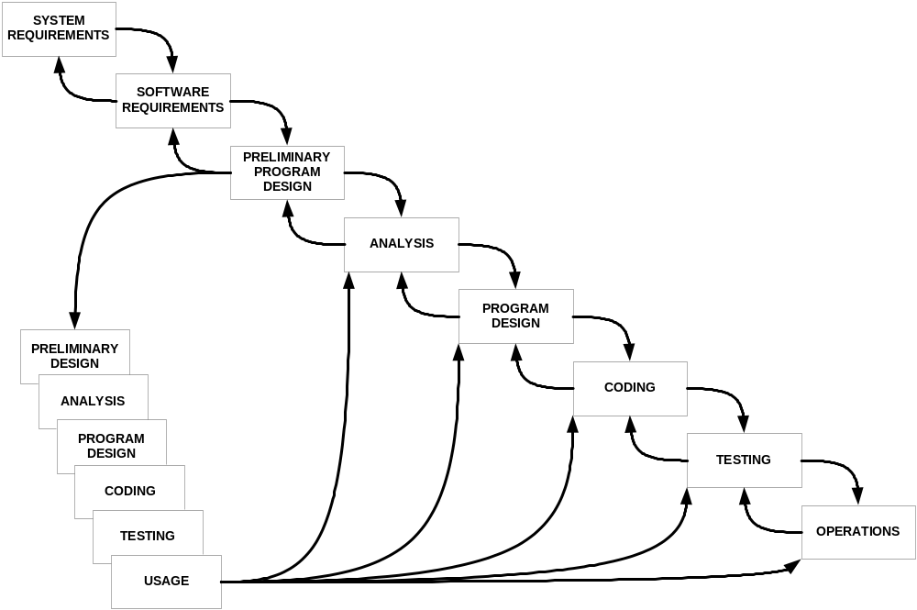
- Explicit feedback
- Prototype: “Do it twice”
Royce Waterfall Model with Prototype

Slide 33
Increase in Software Cost-to-Fix vs. Phase (1976)
1000
1000
Larger Software Projects
500
500
IBM-SSD
200
GTE
200
•
•
100
100
Relative cost to fix defect
80%
•
•
•
50
•
Median (TRW Survey)
50
20%
SAFEGUARD
•
•
•
20
20
•
•
Smaller Software Projects
10
10
•
•
5
•
5
•
•
•
2
2
1
1
Requirements Design Code Development
Requirements Design Code Development
Acceptance Operation
Acceptance Operation
test
test
test
test
Phase in which defect was fixed

Slide 34
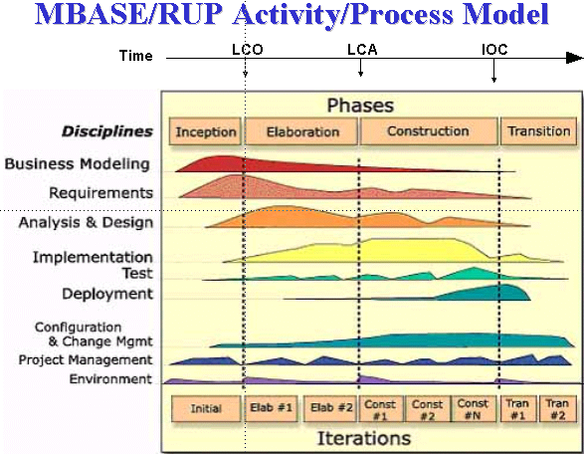
Iterative and Incremental
Develop product in "iterations".
Each iteration adds more capability (incremental).

Slide 35
UP: Formal Iterative & Incremental
Developed by Rational, later bought by IBM
  Rational UP
  Open UP
Characteristics
  plan based
  architecture centric
  address risks early
  implement requirements based on priority
  accommodate change

Slide 36
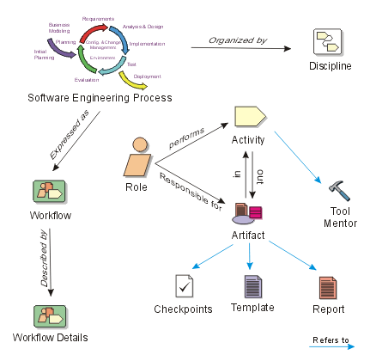
UP Process Model

Slide 37
Activities and Artifacts
Roles
Activity
Input
Output
IEEE xxxx
1. blah blah
2. blah blah
3. blah blah
Tools, technology
Guidance, standards, procedures

Slide 38
What are Roles? Name some...

Slide 39
What are Tasks? Name some...

Slide 40
Other "Disciplined" Processes
Team software process (TSP)
Personal Software Process (PSP)
  objective is to improve personal productivity through staged sequence of activities
  measure and analyze: time, defects
  improvement through reflection and planning

Slide 41
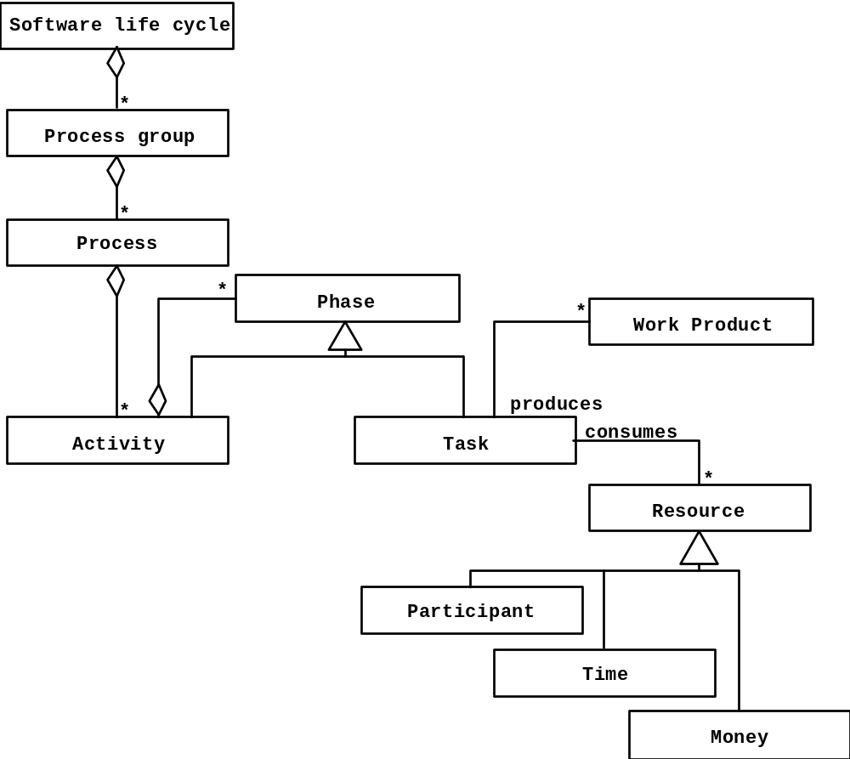
Object Model of the Software Life Cycle
source: Bruegge, OOSE

Slide 42
Agile Manifesto
We are uncovering better ways of developing
software by doing it and helping others do it.
Through this work we have come to value:
Individuals and interactions over processes and tools
Working software over comprehensive
documentation
Customer collaboration over contract negotiation
Responding to change over following a plan
That is, while there is value in the items on
the right, we value the items on the left more.

Slide 43
Agile Process Characteristics
provide customer "value" at each iteration
welcome evolving requirements
working software as primary measure of progress
lack of up-front architecture design (YAGNI)
simplicity of design (XP: "do the simplest thing that ...")
small, self-organizing teams at one site (preferred)
frequent customer feedback
shared understanding instead of comprehensive documents (but they do write docs)

Slide 44
Agile Process Core Practices
CRACK customer representative onsite
  Collaborate
  Representative
  Authoritative
  Committed
  Knowledgeable
Test-driven development
  write test cases first
  constant verification using automatic testing

Slide 45
Agile Process Core Practices (2)
running software at each iteration
frequent face-to-face communications
competant teams
reflection on how to be more effective
well documented, readable code
(XP) pair programming
(XP, Scrum) limit or forbid overtime work

Slide 46
12 Principles of Agile Development
http://agilemanifesto.org/principles.html

Slide 47
Some Agile Processes
eXtreme Programming
  Kent Beck: Chrysler
Scrum (called "more a management technique")
  processes as black boxes
  daily stand-up meeting
Crystal
  a family of methods to address different types of projects
Synchronize and Stabilize (Microsoft process)

Slide 48
Scrum
www.controlchaos.com
  graphic: www.controlchaos.com/about
  audio and video presentation
  interesting "White Papers"
Ken Schwaber, "Scrum Development Process", OOPSLA'95.
  the original Scrum article
Scrum articles:
http://www.controlchaos.com/old-site/articles.htm

Slide 49
Scrum
Easy to add to existing software development process
Often used as "first step" to test benefits of agile dev't
Easy to combine with:
  UP, OpenUP
  XP

Slide 50
Software Process Models
General Models for Software Processes
and Process Improvement

Slide 51
Creating a Defined Process
Meta-thinking
  thinking about what you know / do
Humans are the only animal that consciously changes his behavior
  "learn from experience"
  improvement - creative thinking & insight

Slide 52
Frameworks for Software Processes
There are frameworks for analyzing, evaluating, and (maybe) improving a software process. Best known:
ISO 12207, Software Life Cycle Processes
IEEE 1074, Standard for Software Life Cycle Processes

Slide 53
IEEE Std 1074: Standard for Software Lifecycle
Process Group
IEEE Std 1074
Project
Management
Pre-
Development
Develop-
ment
Post-
Development
Cross-
Development
(Integral Processes)
> Project Initiation
>Project Monitoring
&Control
> Software Quality
Management
> Concept
Exploration
> System
Allocation
> Requirements
Analysis
> Design
> Implemen-
tation
> Installation
> Operation &
Support
> Maintenance
> Retirement
> V & V
> Configuration
Management
> Documen-
tation
> Training
source: Bruegge, OOSE
Processes

Slide 54
IEEE 1074
IEEE Standard for Developing a Software Project Life Cycle Process
Software Project Life Cycle Model
Software Process Architect
Select SPLCM
Select activities
OPAs
uses
incorporates
Software Project Life Cycle

Slide 55
IEEE 1074 Activity Groups (1)
1. Management Activities
Project Initiation
Project Planning
Project Monitoring and Control
2. Pre-Development
Concept Exploration
System Allocation (Architecture Design)
Software Importation

Slide 56
IEEE 1074 Activity Groups (2)
3. Development
Software Requirements
Design
Implementation
4. Post-Development
Installation
Operation and Support
Maintenance
Retirement

Slide 57
IEEE 1074 Activity Groups (3)
5. Support
Evaluation
Software Configuration Management
Documentation Development
Training

Slide 58
Milestone
A scheduled event used to measure progress.
A milestone should be an event with "success" criteria that can be objectively evaluated.
Milestone
Elicit Requirements
Analyze Requirements
Write Specification
Review & Approval
Activities:
Baseline Specification

Slide 59


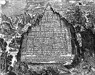
What are Artifacts?
ancient artifacts
http://www.crystalinks.com/emeraldtablet.html

Slide 60
Artifacts
Final Deliverables
  What should we have when we’re finished? (not “what code should we write”)
Interim Deliverables
  What do we need to get the job done?
Internal vs. External Artifacts

Slide 61
Key Artifacts
Interim
Final
Requirements
Analysis & Design Models
Plan Documents
Test Plans, Procedures, Results
Meeting Minutes
Demo Builds
Code Libraries
API Documents
Executables
User Documents
Release Notes
Delivery Bundle
Install Documents

Slide 62
Process Essentials
The following slides are from
CMU 11-791 Software Engineering and IT

Slide 63
Key Process Concepts
Test Infrastructure Early
Reduce Technical Risk
Reduce Schedule Risk
Team for Success
Effective Meetings
Keep Models Updated
Incremental Approach
Synchronize & Stabilize
Code Reviews
Use Issue Tracking
Use Version Control

Slide 64
Test Infrastructure Early
Example: “Which web app framework should I use?”
  Different costs & tradeoffs
  Training, documentation
  Ease of use, stability
  Platform issues, bugs, performance
If there is more than one technology choice for your
infrastructure, a skilled subteam should test or
prototype to enable a clear decision

Slide 65
Reduce Technical Risk
Examples:
  Adopting very new technology
  Novel first use of technology
  No “safer” alternative
Perform a feasibility study (or “proof of concept”)
which demonstrates that the new technology will
work for the function you intend to implement,
on the platform you wish use

Slide 66
Reduce Schedule Risk
Examples:
  Low confidence in estimates
  No data for approach / technology
  Large-scale tasks
    content creation, test data creation, knowledge / rule development, etc.
Gather data on a sample task, extrapolate
Consider automation, tools
Create contingency plan

Slide 67
Team for Success
Leverage skills of team members
  Training / examples for others
  Mentoring, subgroups
  Infrastructure development / support
“Inviting commitment” vs. “Unilateral task assignment”
Frequent post-mortems, process adjustments whenever necessary

Slide 68
Run Effective Meetings
Agenda
  Review action items from last meeting
  Discuss new issues (elicit in meeting, too)
  Assign new action items
  Schedule next meeting
Minutes
  Document attendance (note latecomers)
  Send an email update if you can’t attend!
  Document progress on old action items
  Document decisions and pending issues
  Document new action items
  Email to all members

Slide 69
Effective Meetings [2]
Meeting Roles
  Moderator
    Run the agenda, keep discussion focused and concise
    Make sure all voices are heard
    Tangents noted for later, or saved for a sub-meeting
  Scribe
    Responsible for meeting minutes
  Timekeeper
  Meeting roles should rotate among team members (week to week, phase to phase)

Slide 70
Effective Meetings [3]
Keep meetings brief
  One hour should suffice, except for a working meeting
  The more people, the shorter the meeting (e.g. whole-project meetings should be kept short)
  Spawn sub-group meetings to discuss substantive issues in more detail
  Subgroups report back in main project meeting

Slide 71
Effective Meetings [4]
Participation is essential
  Arrive on time, don’t leave early
  Everyone has a voice
  If absence is unavoidable:
    Send an update to the meeting leader via email
    Read meeting minutes asap and clarify if necessary
    Don’t allow your absence to disrupt the project

Slide 72
Issue-Based Development
Organize teamwork around issues to be resolved as well as code to be written
Document discussion, assumptions, alternative solutions, and resolution for each issue
If assumptions change later, an alternative can be explored
(More in Bruegge & Dutoit)

Slide 73
Keep Models Up To Date
Models are only useful if they describe what you are doing
Models get out of date easily
  Details become visible during development
  Design changes
Link issue resolution to action items: update appropriate models

Slide 74
Consider an Incremental Approach
When working with a hard deadline
A means of mitigating technical and schedule risks
Guarantee you have something to deliver
Development is a series of stable, tested increments
  PRO: Always have working system
  CON: Extra overhead?

Slide 75
Synchronize & Stabilize
“Test early, test often”
At level of individual class, module, or entire system
Synergy with incremental approach
Mitigates estimation risk in system integration
Microsoft’s approach (Cusamano, 1997)

Slide 76
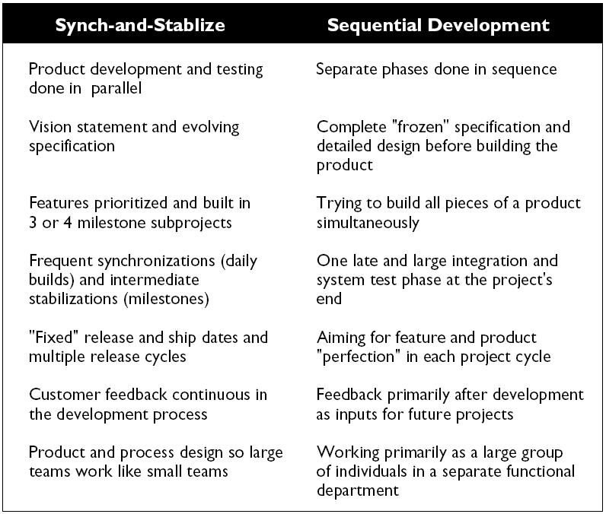
(from Cusamano, 1997)

Slide 77
Use Issue Tracking
Manage enhancements, fixes to
  Code
  Test Suites
  On-line resources (web)
  Written documentation
(See Bugzilla slides from last lecture)

Slide 78
Code Reviews
At each milestone
One module per review
Code examined in advance
Developer leads the meeting
Issues put into bug tracking system
  Source code issues (style, doc)
  Design/implementation mismatches
  Defects
Side-effect: other developers learn how the module works (useful)

Slide 79
CVS: Concurrent Versions System
CVS Home Page:
http://www.cvshome.org/
CVS for new users:
http://www.cvshome.org/new_users.html
Jim Blandy’s tutorial:
http://www.cvshome.org/docs/blandy.html
The Cederqvist manual:
http://www.cvshome.org/docs/manual/cvs.html

Slide 80
Subversion: A Better CVS
http://subversion.tigris.org

Slide 81
Process Improvement

Slide 82
Frameworks for Process Improvement
There are frameworks for analyzing, evaluating, and (maybe) improving a software process. Best known:
Capability Maturity Model Integrated (CMMI), and its earlier version CMM-SW (CMM for Software).
Software Process Improvement Capability Determination (SPICE), ISO 15504, a framework for assessing and comparing software processes.
ISO 9000 - a family of standards for "quality managed systems". Requires a map of all key processes; documented procedures and assessment.

Slide 83
Overview of CMMI - Maturity Levels

Slide 84
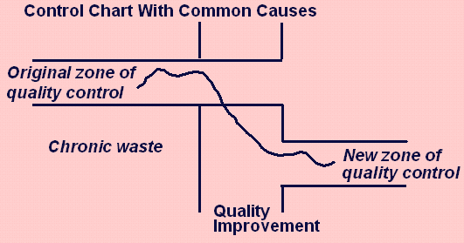
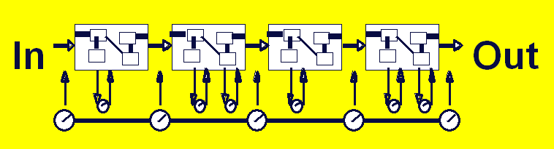
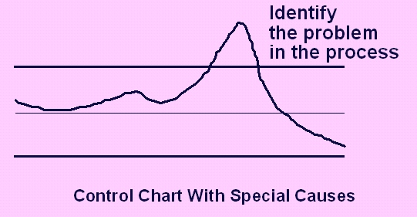



Overview of CMMI - Maturity Levels
5
"Optimizing"
Focus on process improvement;
4
Process measurements; adapt to problems to reduce variance; predictable performance
“Quantitatively
Managed"
3
“Defined"
Process and procedures are standard, managed, improved over time
2
has process model but varies project to project; repeatable
"Managed"
1
ad hoc
not repeatable
"Performed"
0
Outcome
depends
on “heroes”
“Incomplete"

Slide 85
Overview of CMMI - KPA

Slide 86
The CMMI definition of "process"
A “process” [as used in the CMMI Product Suite] consists of activities that can be recognized as implementations of practices in a CMMI model.
These activities can be mapped to one or more practices in CMMI process areas to allow a model to be useful for process improvement and process appraisal. (In Chapter 2, see the definition of “process area” and a description of how this term is used in the CMMI Product Suite.)

Slide 87
SPICE (ISO 15504)
Software Process Improvement and Capability Evaluation
Bloated ISO standard ... not popular outside the EU
5 Types of Processes
1. Engineering
2. Supporting
3. Management
4. Organizational
5. Customer-supplied

Slide 88
Open UP definition of process
An organization of method content into partially ordered sequences for [completing] a software project
What is "method content"?
Roles
Tasks
Artifacts (inputs and outputs)
Guidance
  checklists
  concept documents
  knowledge resources

Slide 89
Software Development Plan
Includes the "Project Management Plan"
What areas does it address?

Slide 90
Configuration Management
In your project there are...
280 source code files
12 files for user documentation
8 project documents (deliverable) such as
SRS
Software Architecture Document
...

Slide 91
Configuration Management (2)
How do you know...
which ones have been tested?
where is the "release 1.0" final version?
have they been reviewed?
what bugs or issues remain (in each file)?

Slide 92
Configuration Management (3)
Configuration Mgmt is part of Development Plan
What artifacts do you want to manage?
Source code
Built code (which one is version 1.0?)
Change requests
Change notification
Bug & Issue tracking

Slide 93
CM: Process
Artifacts
what do you want to manage?
Tasks / Activities
  xx
  xx
Guidance / Standards:
naming convention
version numbering convention
repository organization
what documents go where?
directory structure

Slide 94
Review of Important Concepts

Slide 95
What is a Process?

Slide 96
Engineering versus Programming
Engineers follow procedures, methods, standards to "assure" more predictable results.
No guarantee of quality.
Performance and cost are more predictable.
Measurable.
Verifiable.
Repeatable.

Slide 97
How many Programmers does it take to change a light bulb?
?

Slide 98
How many Programmers does it take to change a light bulb?
None.
A defective light bulb is a hardware problem.

Slide 99
How many Software Engineers does it take to change a light bulb?

Slide 100
How many Software Engineers does it take to change a light bulb?
Six.
Analyst to write the specification.
Architect to design a light-bulb changing procedure.
Developer to change the light bulb.
Tester to test it.
Documenter to write project reports.
Auditor to verify that the process was followed.

Slide 101
How many Programmers does it take to write a "Hello World" program?
?

Slide 102
How many Programmers does it take to write a "Hello World" program?
One.

Slide 103
How many eXtreme Programmers does it take to write a "Hello World" program?
?

Slide 104
How many eXtreme Programmers does it take to write a "Hello World" program?
Two
XP requires that you always do "pair programming".
But they can write "Hello World" much faster.

Slide 105
How many Software Engineers to write a "Hello World" program?

Slide 106
How many Software Engineers to write a "Hello World" program?
Six.
Analyst to write the specification.
Architect to design the program.
Developer to write it.
Tester to test it.
Documenter to write the user guide.
Auditor to verify that the process was followed.

Slide 107
How many people to write a IEEE1074 compliant "Hello World" program?

Slide 108
How many people to write a IEEE1074 compliant "Hello World" program?
Seven.
Software Process Architect to design the process.
Analyst to write the specification.
Architect to design the program.
Developer to write it.
Tester to test it.
Documenter to write the user guide.
Auditor to verify that the process was followed.

